Slide 1
Taping OAI
Process Improvement…
By Zulhisham Tan – S1609
15th December 2011

Slide 2

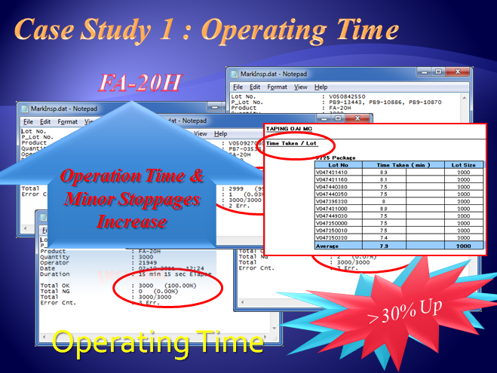
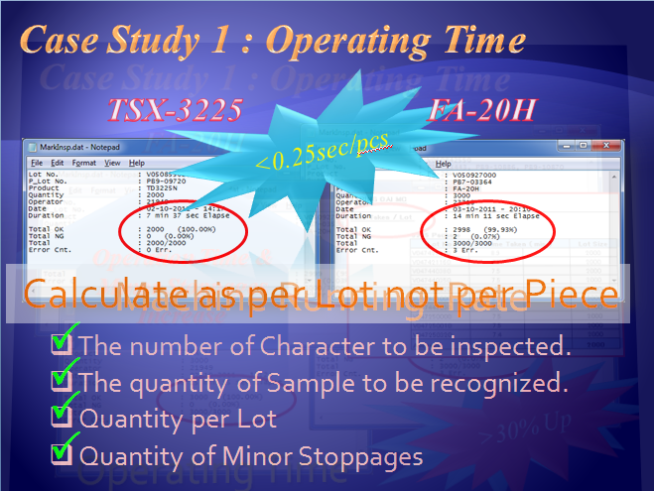
Recap – Accuracy Vs Output
Accuracy
Output
Cycle Time
The number of Character to be inspected.
The quantity of Sample to be recognized.
Quantity per Lot
Quantity of Minor Stoppages

Slide 3

Recap – Establish New Approach
Objective !
To reduce Taping OAI workmanship by 50% with
Review Taping OAI Standard
Implement Taping OAI machine using new Judgment standard
New OAI Judgment Standard
Objective is to detect Sealing Defect (by worker).
To detect Tape Broken (by worker).
To detect Mixing (by machine) – Check Freq. & CL only.
P
Target
Machine Cycle Time : < 0.2 sec
P
6 Machines Ability : 55 mil
P
Confirming Rate : 99%
P
Running Rate : 90%
P
Machine Availability : 29 days; 21.75 hrs

Slide 4
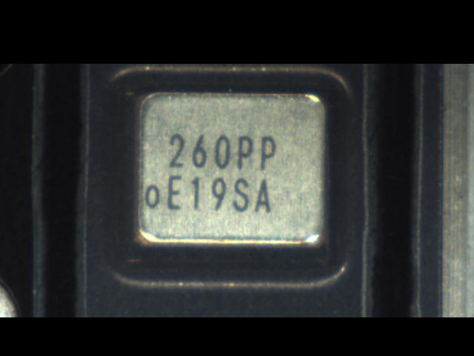
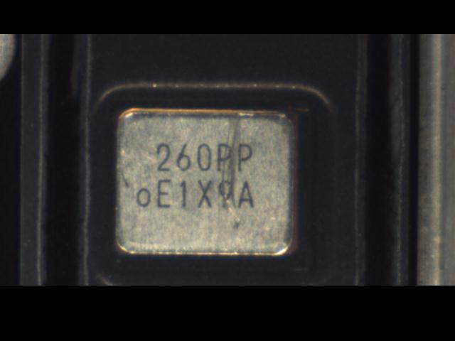
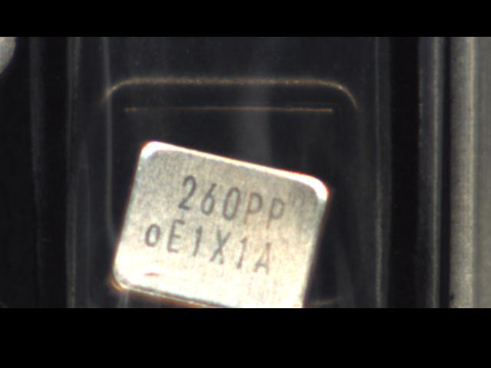
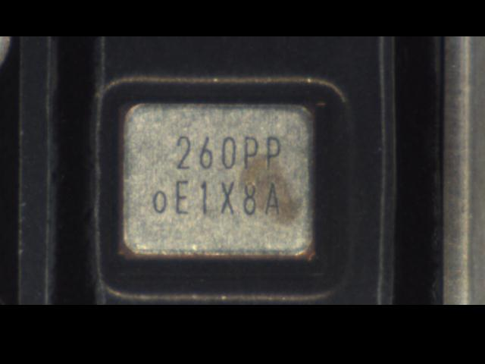
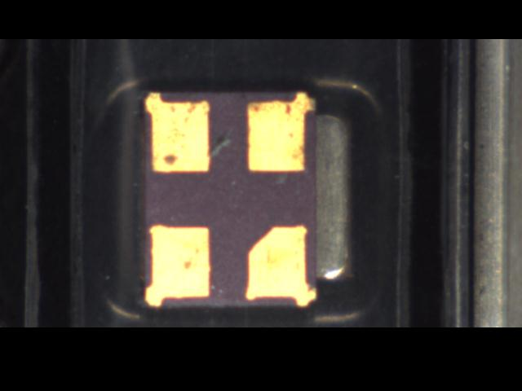
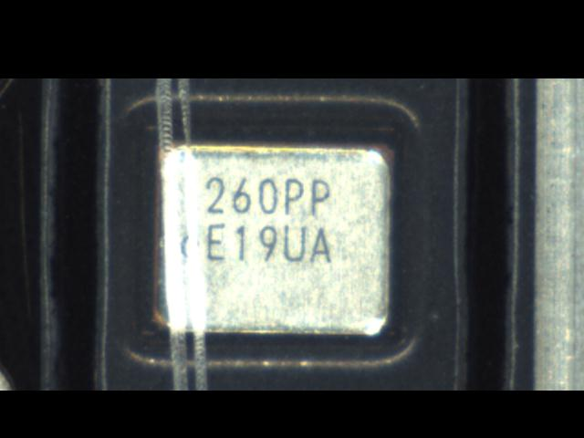
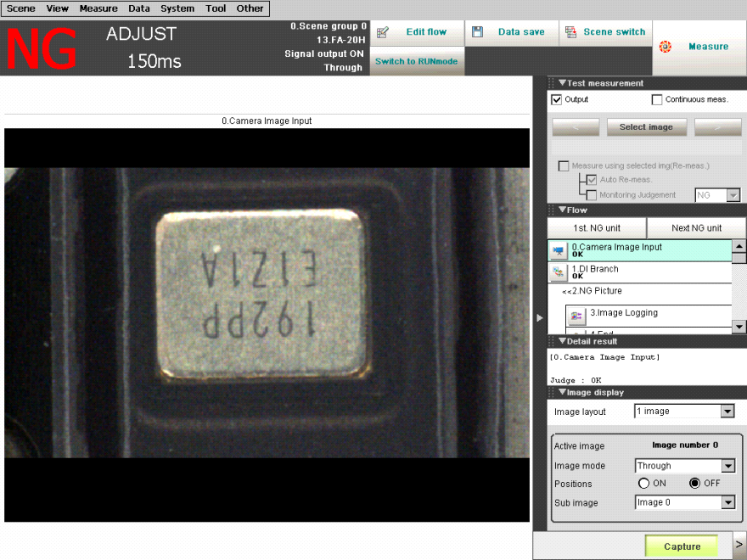
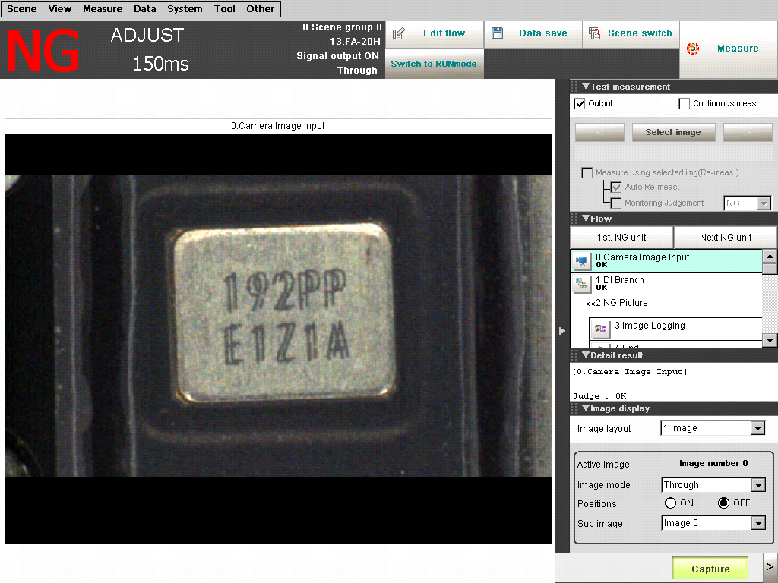
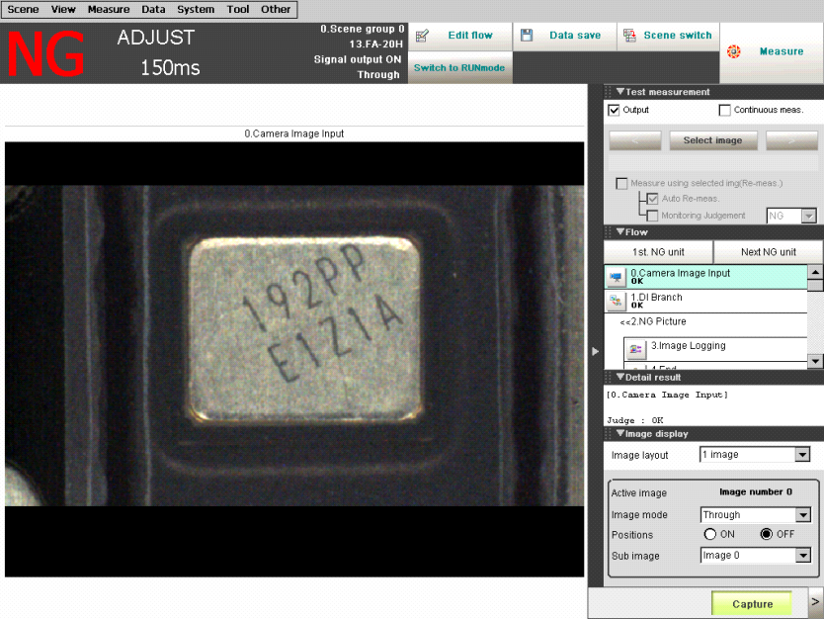
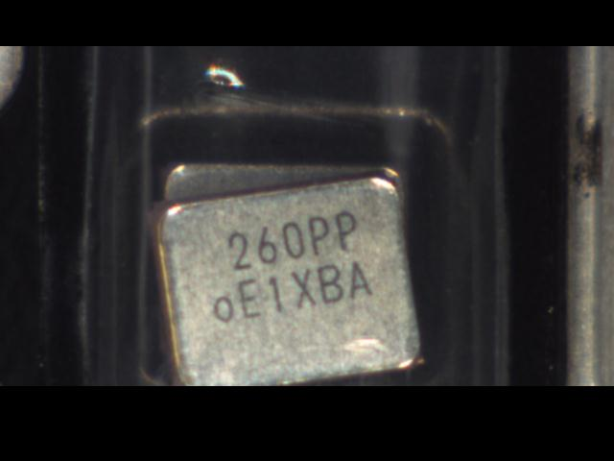
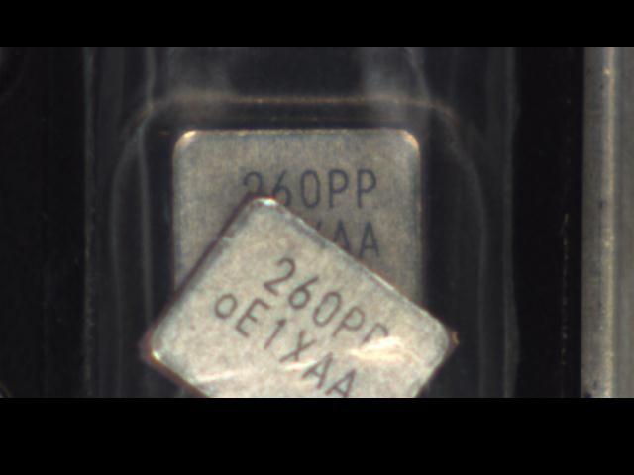
Recap – Critical OAI Items
P
Frequency Mixing
P
CL Mixing
5
O
/
Mixing Week Code
9
P
Marking Shift
O
Wrong Direction
Not Available Taping OAI
P
Inverse Direction
O
Double Pieces
O
Double Marking
O
Sealing Inspection

Slide 5
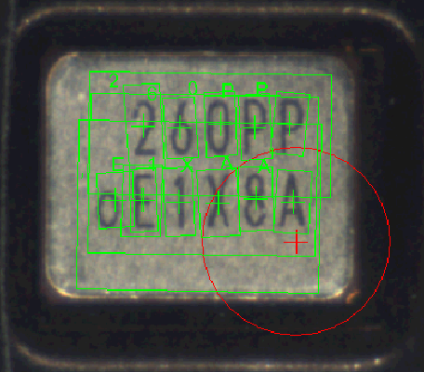
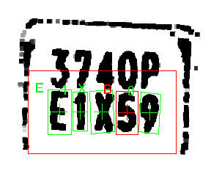
Case Study : Accuracy (Mixing)
Q = 0
A = 4,8
K = R
H = N
S = 8
Wrong Judgment
B = 8,5,E
T = 1
Incoming Material & Marking Condition
R = N
E = F,B
Resolution of the Camera & and the Vision Controller

Slide 6
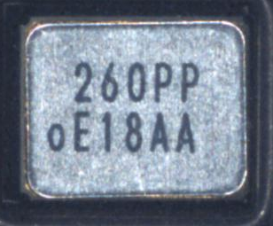
Merits Of New Approach
0 ~ 9 + P = 11
Accuracy
Output
Cycle Time
Reduce Fault Tolerance
0 ~ 9 ; A~ Z = 36
Reduce Minor Stoppages
Reduce Inspection Qty.
Machine Cycle Time < 0.2 sec
Reduce Operation Time
Increase Production Output

Slide 7
Mixing Of Weekcode
No Customer Claim
Not Required By Customer

Slide 8

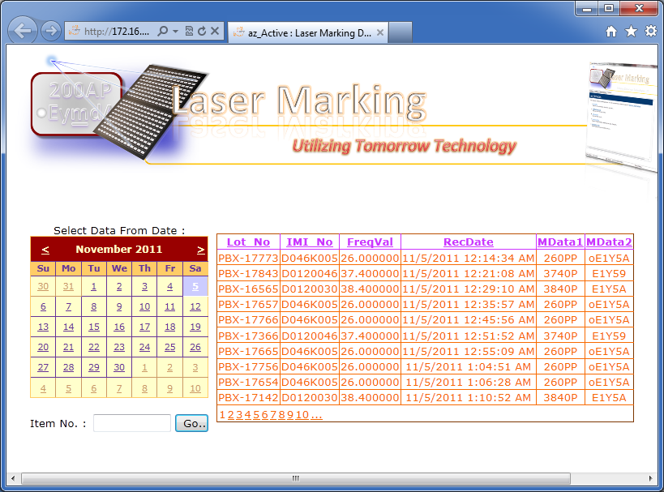
Cause & Effect : Traceability Data
Customer Claim
CSQA
Web based Application
Week Code
Taping Lot No.
IMI No.
Machinery Network : Traceability Data
Mother Lot No.
PDCA

Slide 9
New Approach Result
Machine Cycle
< 0.2 sec
Average < 10min per Lot (3000 Lot Size)

Slide 10
Effectiveness
Inspection Type | Cycle Time = 0.19 sec |  | Cycle Time = 0.28 sec
 | FA-128P | FA-20HP | FA-128P | FA-20HP
Frequency Mixing | P | P | P | P
CL Mixing | P | P | P | P
Mixing Weekcode | O | O | P | P
Weekcode Jumping | O | O | P | P
Marking Shift/Inverse | P | P | P | P
Wrong Direction | O | O | O | O
Double Pieces | O | O | O | O
Double Marking | O | O | O | O
Sealing Inspection | O | O | O | O
Ability 1 Machine | 9082.80 Kpcs/month |  | 5950.80 Kpcs/month
Ability 6 Machine | 54496.8 Kpcs/month |  | 35704.80 Kpcs/month
Customer Claim (FA-128)
QC Reject
Customer Claim (FA-238)

Slide 11
Wrong Direction
0 Cases for FA-20H & FA-20HP due to the Carrier Tape is black color, hence could not be checked.
No Customer Claim

Slide 12
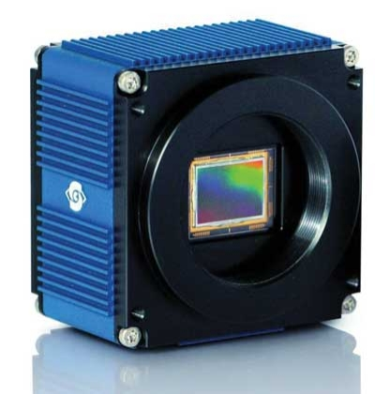
Double Pieces & Double Marking
Size of the package
Thickness of the package
Focus
Working Region
Marking Inspection Result
O
Double Pieces
O
Double Marking

Slide 13
Double Pieces
Due to the target is within the working region, the vision still able to measure the marking data, hence double pieces unable to detect.

Slide 14
Double Pieces

Slide 15
Double Marking
Double Marking detection is also depends on the focusing point of the vision system. In the case shown above, if focus is not good, it probably able to read the character since the line is slightly become thicker.

Slide 16
QC Reject : Double Marking
No Customer Claim
Not Required By Customer

Slide 17
Sealing Inspection
Difficulties in identifying the Sealing Area
Inconsistent Measurement cause M/C Stopages

Slide 18
Conclusion
Inspection Type | Cycle Time = 0.19 sec |  | Cycle Time = 0.28 sec |  | QC Reject | Cust. Claim | Propose
 | FA-128P | FA-20HP | FA-128P | FA-20HP
Frequency Mixing | P | P | P | P |  | Yes
CL Mixing | P | P | P | P |  | Yes
Mixing Weekcode | O | O | P | P | Yes | No | No
Weekcode Jumping | O | O | P | P | Yes | No | No
Marking Shift | P | P | P | P
Wrong Direction | O | O | O | O
Double Pieces | O | O | O | O
Double Marking | O | O | O | O
Sealing Inspection | O | O | O | O |  | Yes
Ability 1 Machine | 9082.80 Kpcs/month |  | 5950.80 Kpcs/month
Ability 6 Machine | 54496.8 Kpcs/month |  | 35704.80 Kpcs/month
By Worker
Machine Cycle
< 0.2 sec

Slide 19
Conclusion
Inspection Type | Cycle Time = 0.19 sec |  | Cycle Time = 0.28 sec |  | QC Reject | Cust. Claim | Propose
 | FA-128P | FA-20HP | FA-128P | FA-20HP
Frequency Mixing | P | P | P | P |  | Yes
CL Mixing | P | P | P | P |  | Yes
Mixing Weekcode | O | O | P | P | Yes | No | No
Weekcode Jumping | O | O | P | P | Yes | No | No
Marking Shift | P | P | P | P
Wrong Direction | O | O | O | O
Double Pieces | O | O | O | O
Double Marking | O | O | O | O
Sealing Inspection | O | O | O | O |  | Yes
Ability 1 Machine | 9082.80 Kpcs/month |  | 5950.80 Kpcs/month
Ability 6 Machine | 54496.8 Kpcs/month |  | 35704.80 Kpcs/month
Only FA-128 & FA-20H (Machine not yet full loading).
Without Week Code Inspection is not yet approve by Management.
Software that without Week Code inspection not yet approved.
More than 2 mins per Lot by Worker
50% Worker Reduction is not yet achieved!

Slide 20
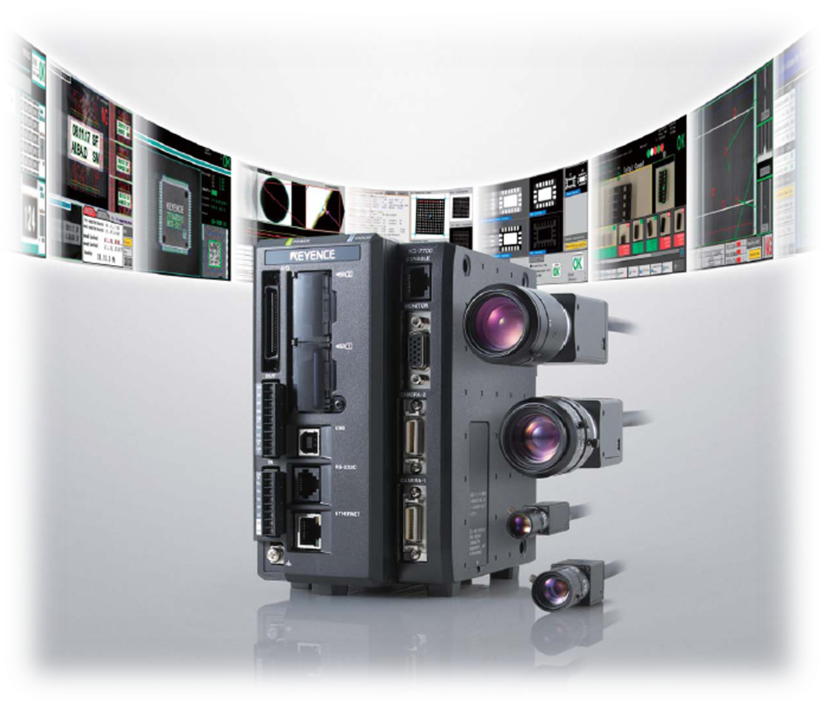


Study Case : Technologies
P
More Flexible & Power
P
Higher Level of Control
P
Higher Accuracy

Slide 21
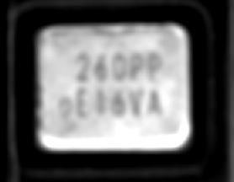
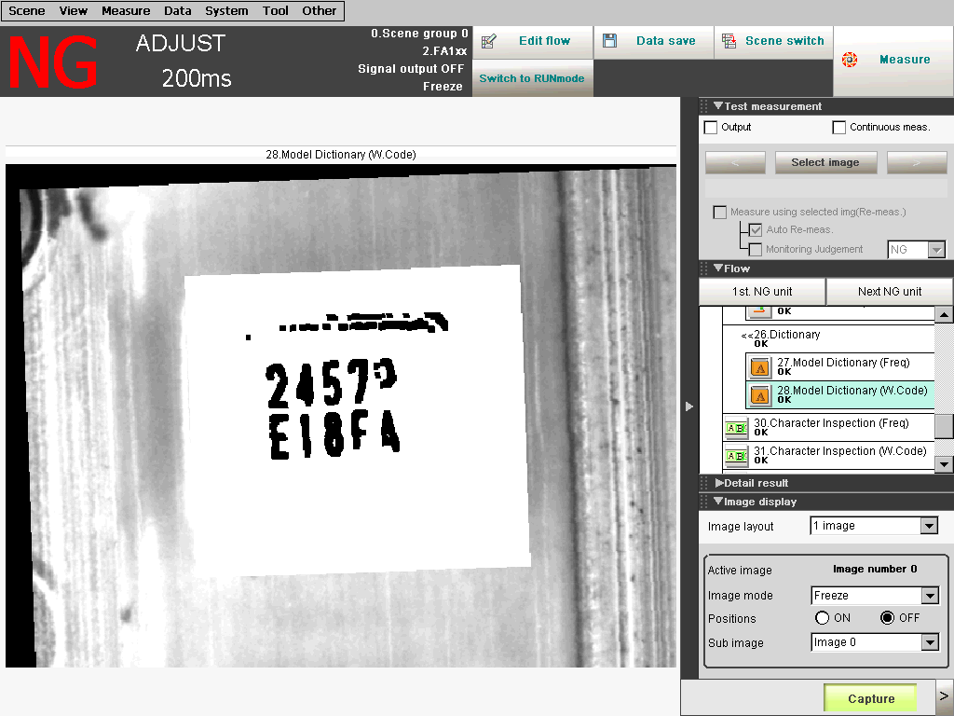
Study Case : Technologies
Technique Of Image Processing

Slide 22
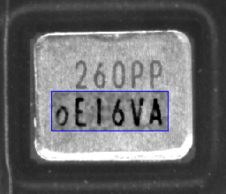
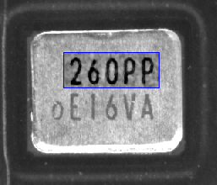
Study Case : Technologies
Technique Of Image Processing
150 msec Measurement Time
60 msec Measurement Time

Slide 23
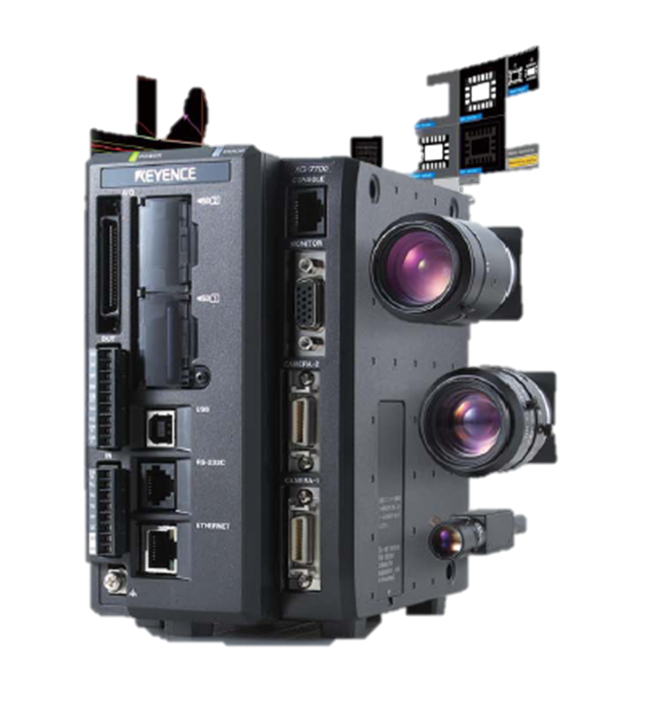
Schedule System Evaluation
P
Learn To Program
P
Establish Communication
Integrate To Taping OAI
System Evaluation
Today
Dec ‘11

Slide 24
Pathway To The 50% Worker Reduction
Keyence System Evaluation
Implement All Code
Evaluation of Implementation
Mar ‘12

Slide 25

Collaboration Of Hitting The Target
10 U! ☺

